Slide 1
All about me…..and you!
This book is designed to be completed with pictures and sequence options.
The students can use their social vocabulary to talk about themselves and ask others about themselves.
The social page was designed to be interactive.
You can change the order of the pages to have the student initiate, state or respond.
Feel free to introduce in parts.
A template is included if you would like to add to the story.
Story begins with slide 5
WordPower 42

Slide 2
Asking questions
Student can either say “how about you?
Or
Tap “social questions” and toggle back to “personal”
The student can vary between both options.
One page will be created for “how about you?” which can be used when desired.
The prompt pages will create the sequence based on starting with the Personal page.
WordPower 42

Slide 3
If initiating the conversation with a ?
WordPower 42

Slide 4
Template
Snip picture of button
and place here.
Insert photo to fit the topic of sentence strip below.
I __________________________________________________________________
Snip picture of button
and place here.
WordPower 42

Slide 5
All about me!
Insert client photo here
WordPower 42

Slide 6
Name
Insert photo of client.
Fill in client name below.
My name is _________________________
WordPower 42

Slide 7
Insert photo of client.
Fill in client name below.
What’s your name?
WordPower 42

Slide 8
How about you?
WordPower 42

Slide 9
Moving between Personal and Social Questions
Tapping between these two will allow student to ask and answer questions.
WordPower 42

Slide 10
Address
Insert photo of client house, a house,
picture of state client lives in,
or something that represents a home.
Fill in address info on line below.
I live at __________________________________________________________________
WordPower 42

Slide 11
Insert photo of client.
Fill in client name below.
Where do you live?
WordPower 42

Slide 12
Birthday
Cut/copy and paste birthday month here
Fill in day in next
square. Write birthday on line below.
My birthday is _________________________________________________
WordPower 42

Slide 13
Insert photo of client.
Fill in client name below.
When is your birthday?
WordPower 42

Slide 14
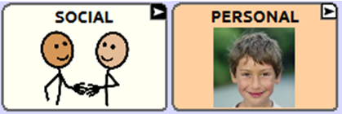
Age
I am ________ years old
WordPower 42

Slide 15
Insert photo of client.
Fill in client name below.
How old are you?
WordPower 42

Slide 16
School
Insert photo of school.
Write or type in school name on line below.
I go to school at __________________________________________________________________
WordPower 42

Slide 17
Insert photo of client.
Fill in client name below.
Where do you go to school?
WordPower 42

Slide 18
Favorite TV Show
Insert photo of favorite TV Show.
Fill in name of show on line below.
My favorite TV show is___________________________________________________________
WordPower 42

Slide 19
Insert photo of client.
Fill in client name below.
What’s your favorite TV show?
WordPower 42

Slide 20
I like to
Insert photo of something client likes to do.
Fill in “like” below.
I like to _________________________________________________________
WordPower 42

Slide 21
Insert photo of client.
Fill in client name below.
What do you like to do?
WordPower 42

Slide 22
My pets
Insert photo of client’s pet (s)
Fill in pet info on line below.
I have __________________________________________________________________
WordPower 42

Slide 23
Insert photo of client.
Fill in client name below.
Do you have any pets?
WordPower 42

Slide 24
Birthday month
WordPower 42

Slide 25
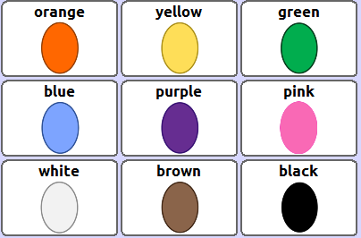
Favorite color
My favorite color is _________________.
WordPower 42

Slide 26
Hair
I have _________________ hair.
WordPower 42

Slide 27
Colors
WordPower 42

Slide 28
Hair
or
My hair is _________________ .
WordPower 42

Slide 29
Describing hair options
WordPower 42

Slide 30
Hair
My hair is _________________ .
WordPower 42

Slide 31
Hair
My hair is _________________ .
WordPower 42

