Slide 1
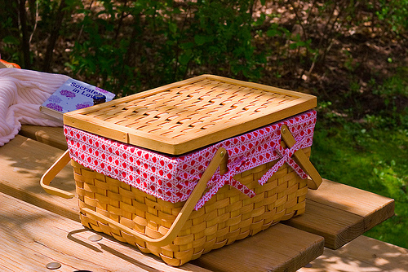
Going on a Picnic By: soldiersmom
*modified for workshop

Slide 2
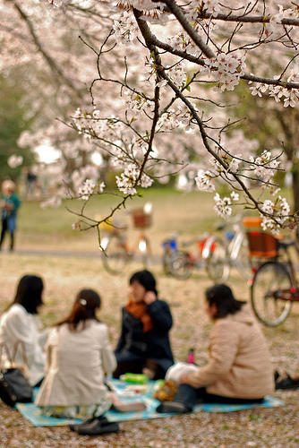
We will spend some time with good friends.

Slide 3
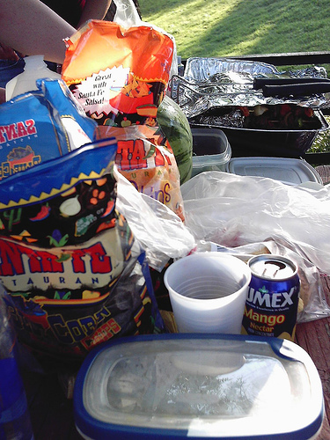
We'll pack a lunch.

Slide 4
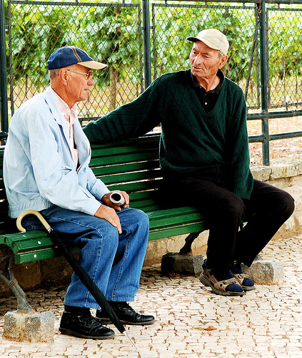
Meet at the park.

Slide 5
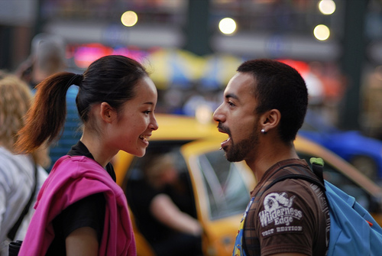
What might we need to buy at the store to eat?

Slide 6
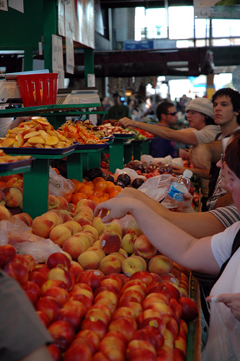
Fruit sounds good.

Slide 7
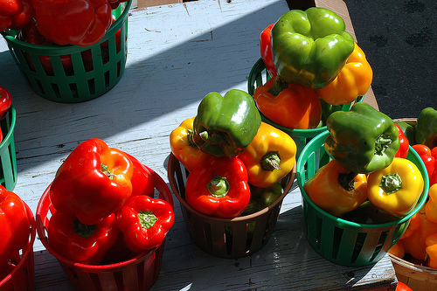
How about some vegetables and dip?

Slide 8
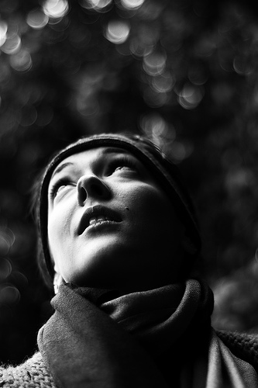
What else sounds good?

Slide 9
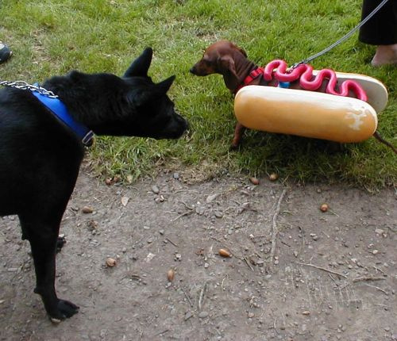
How about a couple of hot dogs?

Slide 10
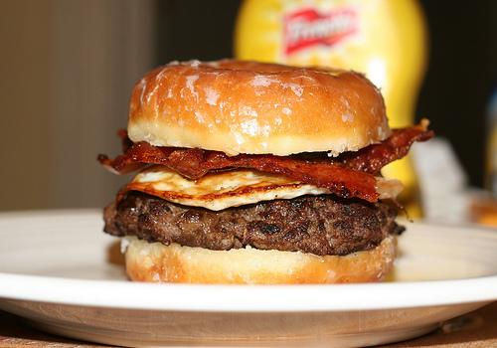
Maybe you want a burger.

Slide 11
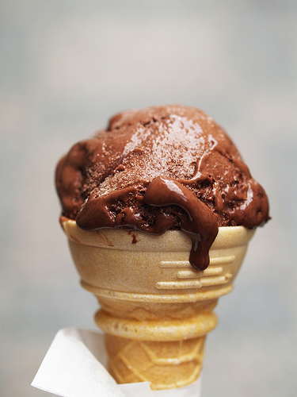
We want ice cream!

Slide 12
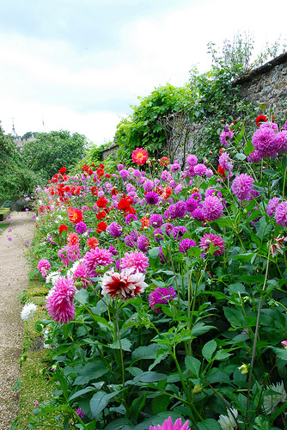
Stop and smell the flowers.

Slide 13
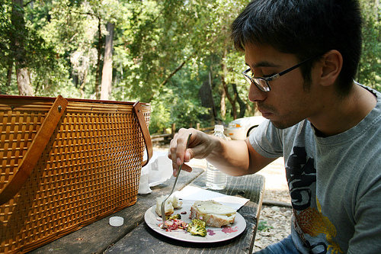
Enjoy the day!

