Slide 1
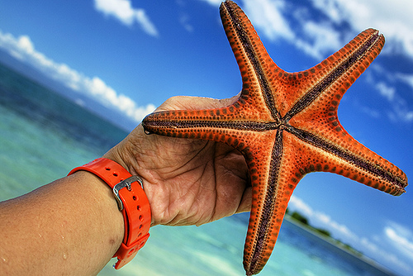
A Day at the Beach kmonacella
*modified for workshop

Slide 2
A Day at the Beach

Slide 3
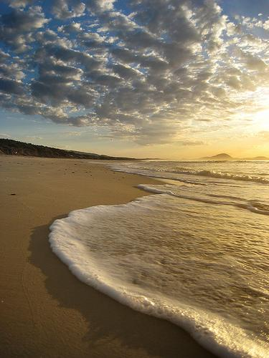
At the beach, there is sand and water.

Slide 4
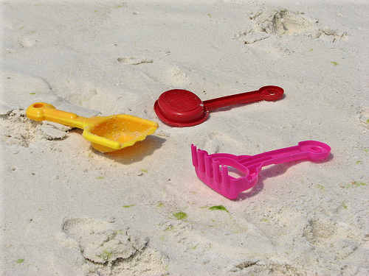
You can play in the sand with sand toys!

Slide 5
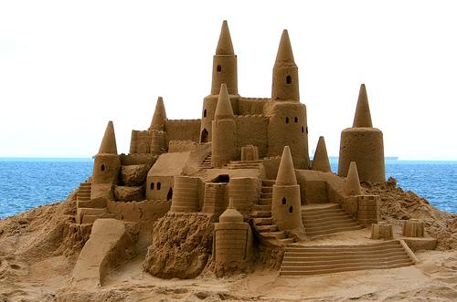
Have you ever built a sand castle? Wow!

Slide 6
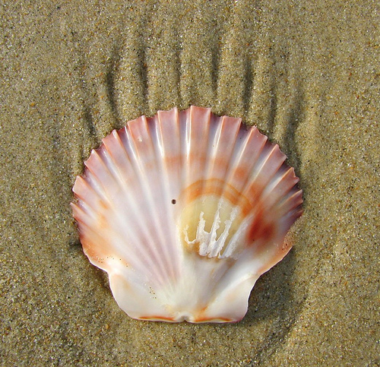
At the beach, you can look for seashells! This one is very pretty.

Slide 7
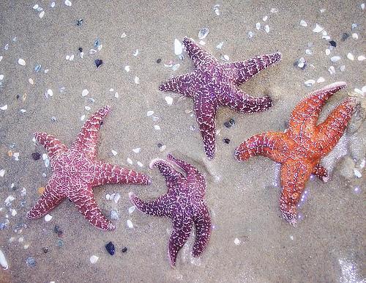
You might even find a starfish!

Slide 8
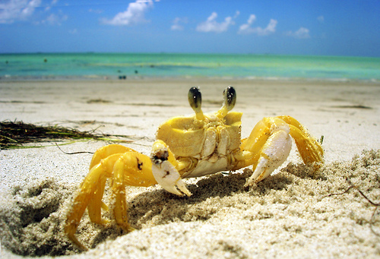
Maybe you will see a crab on the beach!

Slide 9
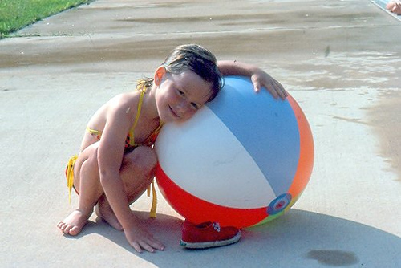
At the beach, you can play with a beach ball.

Slide 10
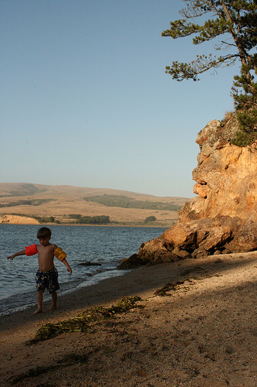
There is so much to explore at the beach!

